Slide 1
Lecture 15 October 7,2019
3-4 guidelines—Any questions? READ guidelines and lab handout, and plan before you write. Start discussion by revisiting the data. Write about the data. Make conclusions about the data. Limit opinion statements. Make your lab report usable by another student.
*Chi Square analysis should be done first on your data (counted by you and partner) and a second time on the compiled/total counts of the class.

Slide 2
This week in lab…
Starting Drosophila genetics. Looking at some X-linked traits and learning how to care for and cross fruit flies.

Slide 3
It’s Nobel Prize week!!!
Prize in Medicine and Physiology-—3 scientists who study hypoxia. Low oxygen.
One important area in which hypoxia is important in cancer biology. In solid tumors, the cells in the center regions of the tumors don’t get as much oxygen as those in closer proximity to blood vessels on the outside of the tumor.
READ more about the scientists and the field!

Slide 4
Where were we?....
Pedigrees—construct a pedigree for your immediate (and as many generations as you can) family showing attached earlobes.
Make yourself the proband if you have attached earlobes. Make someone else the proband, if not.
Share with other classmates to see if you can determine if attached earlobes is dominant or recessive. (It is known to be a one-gene trait)

Slide 6
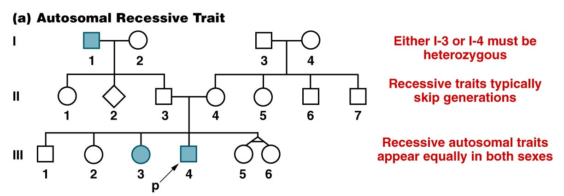
PRACTICE PEDIGREES!!
…but not always!
“ Autosomal” refers to chromosomes which have no role in sex determination. In humans, chromosomes 1-22 are autosomes, X and Y are sex chromosomes.
Figure 3.14a
Notes:
Figure 3-14a A representative pedigree for an autosomal recessive trait followed through three generations.

Slide 7
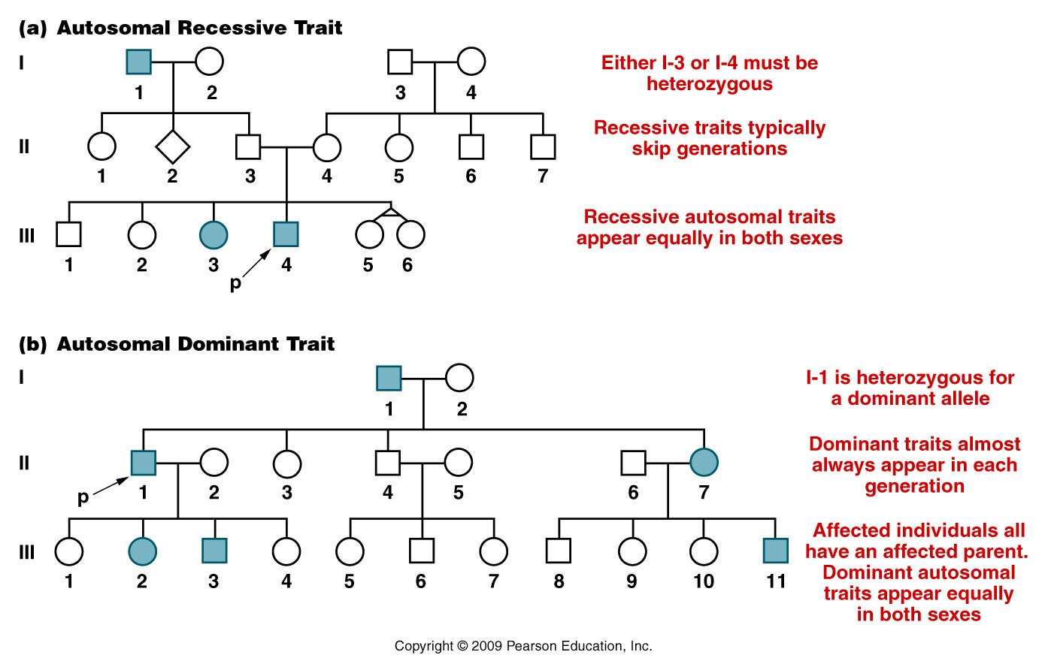
Figure 3.14
Notes:
Figure 3-14 (a) A representative pedigree for an autosomal recessive trait followed through three generations. (b) A representative pedigree for an autosomal dominant trait followed through three generations.

Slide 8
The following are a partial list of genetic human traits which cause problems in basic living---So we call them diseases.
Not all genetic traits are diseases. Not all diseases are genetic.
Your book has a short list in table 3.4

Slide 11
Recessive traits/diseases
Going beyond symbols and names---how generally do we think of a recessive trait?
An individual must inherit 2 recessive alleles to express the trait.
What might the recessive alleles represent?

Slide 12
example…autosomal recessive Albinism

Slide 13
Let’s think about recessive traits…
Albinism AA or Aa genotype---normal pigmentation
aa genotype no skin/hair/eye pigment
Molecular explanation? The “A” gene controls production of skin pigment---melanin.
A allele= normal/wild-type allele
a allele= abnormal/mutant/non-functional allele
A__ normal pigment aa no pigment
(one normal allele is sufficient for normal pigmentation)

Slide 14
Tay-Sachs disease
Another great example of a disease caused by a recessive allele of a gene.
The allele is rare in the population as a whole, but shows how populations which are geographically or culturally isolated can greatly increase the frequency of any allele.
(1/27 Ashkenazi Jews (Jews of central or eastern European descent) is a heterozygous carrier of the Tay Sachs allele.) Among other Jewish groups only 1/250 are carriers.
P.61-62---Read about the molecular explanation for the disease! What gene is involved? HEXA

Slide 15
Read about HEXA gene
http://ghr.nlm.nih.gov/condition/tay-sachs-disease
P. 62 of text
Genetics Home Reference website---put Tay Sachs in the search box.

Slide 16
Lets think about dominant traits…
Huntington disease—
hh-normal
Hh or HH has the neurological disease
The presence of 1 abnormal allele, somehow overrides the function of the normal allele
OR
A single copy of the normal allele is not sufficient for normal neurological function

Slide 17
Huntington Disease…
Great example of a disease caused by a dominant allele of a gene.
Overall, dominant diseases (and the alleles that cause them) are fairly rare in the population.
Why? There are no “unaffected carriers” . Individuals who carry the allele, always show the trait (have the disease) so they may not be able to reproduce or may opt not to.

Slide 18
Huntington Disease…
Particularly tragic because it does not develop until late life---sometimes 40 years of age or older.
Affected individuals may have already had children.
What is the probability that an idividual with Huntington disease will have a child with the disease? (Assume the huntingon alleles is rare).

Slide 19
HTT gene—read about it
http://ghr.nlm.nih.gov/condition/huntington-disease
Genetics Home Reference website---put Huntington disease in the search box.

Slide 20
Always return to molecular explanations for traits.
gene/allele RNA (protein) effect/trait/characteristic
Different alleles give rise to different forms of the same protein---explaining specific traits.

Slide 21
Moving on…
Chapter 4 reminds us that genetics gets a bit more complex than Mendel’s 1-gene, 2 allele, complete dominant/recessive traits.
For example…..

Slide 22
Some traits show incomplete or co-dominance
Some traits are controlled by single genes with 3 or more alleles in the population
Some traits are controlled by 2 or more genes
Some genes influence or stop the expression of others
Expression of some genes is highly dependent on nutritional factors or other environmental factors

Slide 23
But we will start with…sex linked traits….
Why? Because you are now familiar with pedigrees---AND we are starting to use Drosophila in lab to look at sex-linked traits.
Most specific definition: A trait controlled by one or more genes located on the X or Y chromosome---chromosomes associated with sex (male or female) DETERMINATION.

Slide 24
Don’t confuse with sex-influence or sex-limited traits.
These are traits that differ in inheritance or are limited to being expressed in one sex.
IMPORTANT! Sex-linked traits can be seen in both sexes.

Slide 25
On the board
Let’s do a pedigree for a family, showing transmission of X and Y chromosomes from parent to offspring.
To understand sex-linked traits you must first master this idea---and then superimpose traits to see if they fit an X or Y linked pattern.

Slide 26
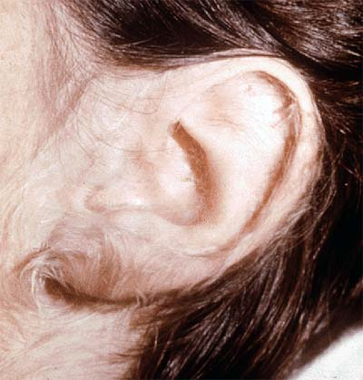
Start with a rare Y-linked trait. (So few genes on Y that these traits are rarely noted.)
“hairy ear” trait has been mapped to a gene on the Y chromosome.

Slide 27
For example---hairy ears

Slide 28
Be careful---does every male in the pedigree show hairy ears? Why or why not?
Do females ever show the trait? Why or why not?
Can the trait skip a generation? Why or why not?

Slide 29
X-linked traits
Much more common than Y-linked traits (many more genes on X)
First recognized in Drosophila by Thomas Morgan
Noted different outcomes in reciprocal crosses (different out comes, swithing the male and female parents with respect to traits.
Noted that the white eye trait was inherited in a sex-linked way---concluded that the white mutation was in a gene on the X-chromosome

Slide 30
To study, you must track both the trait and the sex of the organism showing the trait.
Let’s review Drosophila eye color. White eyes is a recessive trait. The dominant color is red.
The inheritance of white eyes looks different from the autosomal recessive traits we’ve seen so far---depending on how the cross is setup.

Slide 31
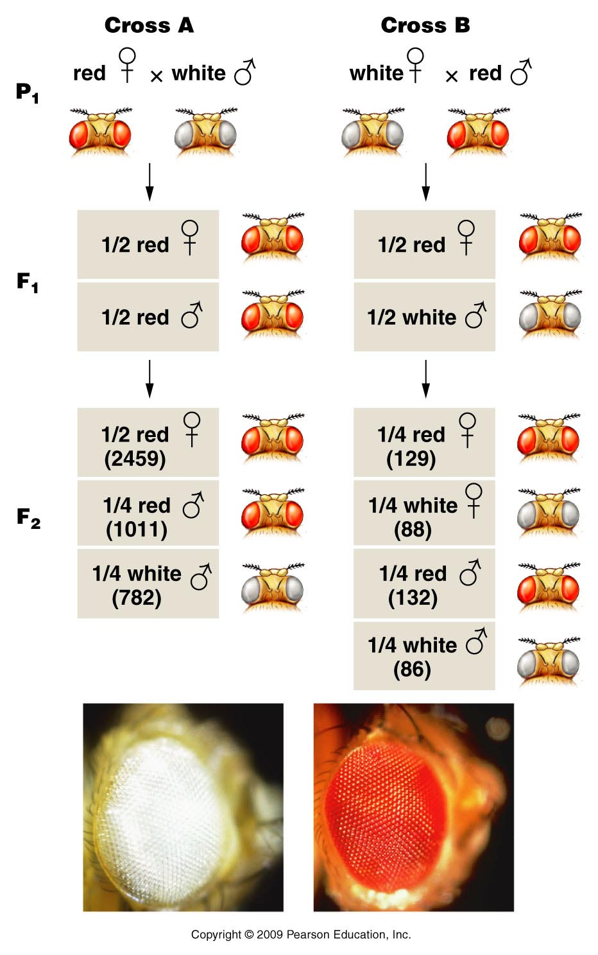
Unlike Mendel, Morgan noted differences in reciprocal crosses
F1 shows both parental traits
3:1 but only males have white eyes
F2 shows 1:1 ratio
Figure 4.12
Notes:
Figure 4-12 The F¹ and F² results of T. H. Morgan’s reciprocal crosses involving the X-linked white mutation in Drosophila melanogaster. The actual data are shown in parentheses. The photographs show white eye and the brick-red wild-type eye color.

Slide 32
Morgan proposed, that the gene controlling eye color was sex-linked. The fact that only males had white eyes in the F1 of cross A suggested X-linked.
He tried the following scheme to explain the unexpected pattern of inheritance.

Slide 33
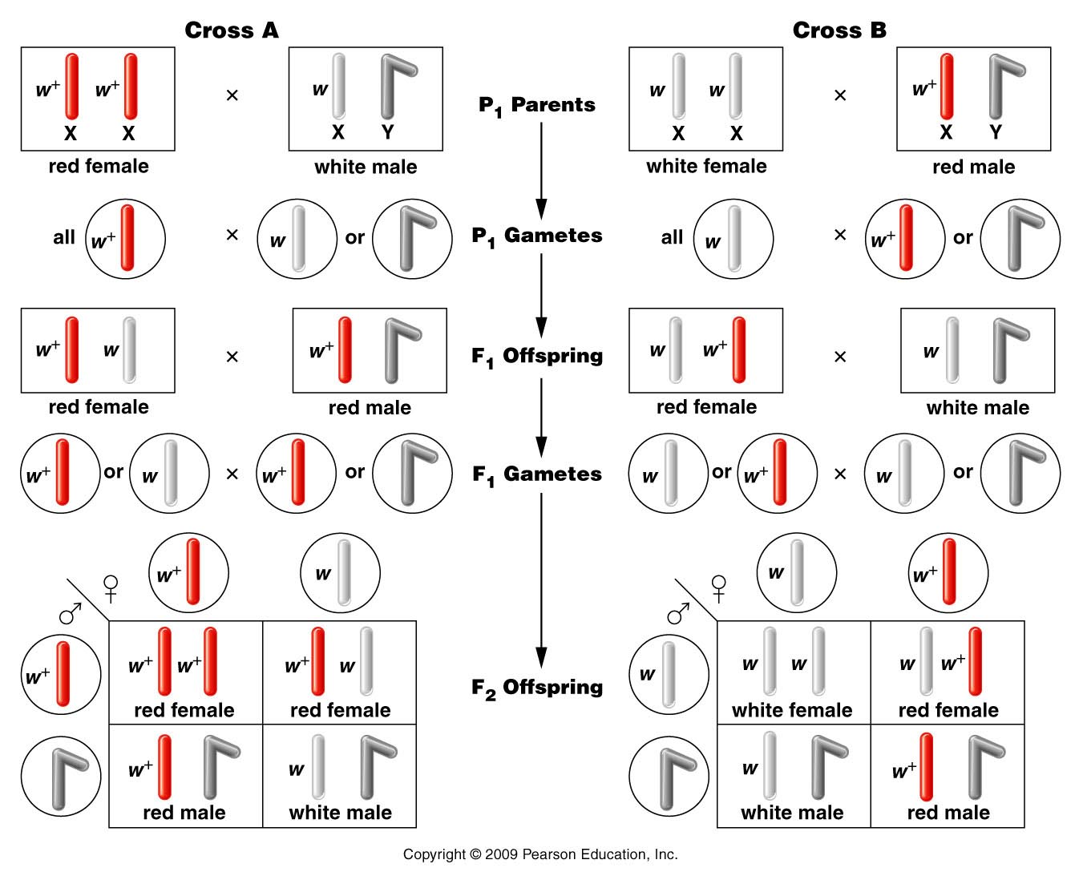
Figure 4.13
Notes:
Figure 4-13 The chromosomal explanation of the results of the X-linked crosses shown in Figure 4–11.

Slide 34
Figure 4.13
Notes:
Figure 4-13 The chromosomal explanation of the results of the X-linked crosses shown in Figure 4–11.

Slide 35
The hypothesis that the w (white) allele was located on the X chromosome, is consistent with patterns of inheritance in both reciprocal crosses.
Sex-linkage is just one of the extensions to Mendel’s observations we have discovered while studying inheritance.

